Slide 1




USWDS Monthly Call
February 2023

Slide 2

Hi!
Thanks for being here!

Slide 3
Agenda
Site launches
USWDS 3.4.0
Top tasks survey
Design tokens
Q&A

Slide 4
Site launches

Slide 5

U.S. Department of Justice
justice.gov

Slide 6
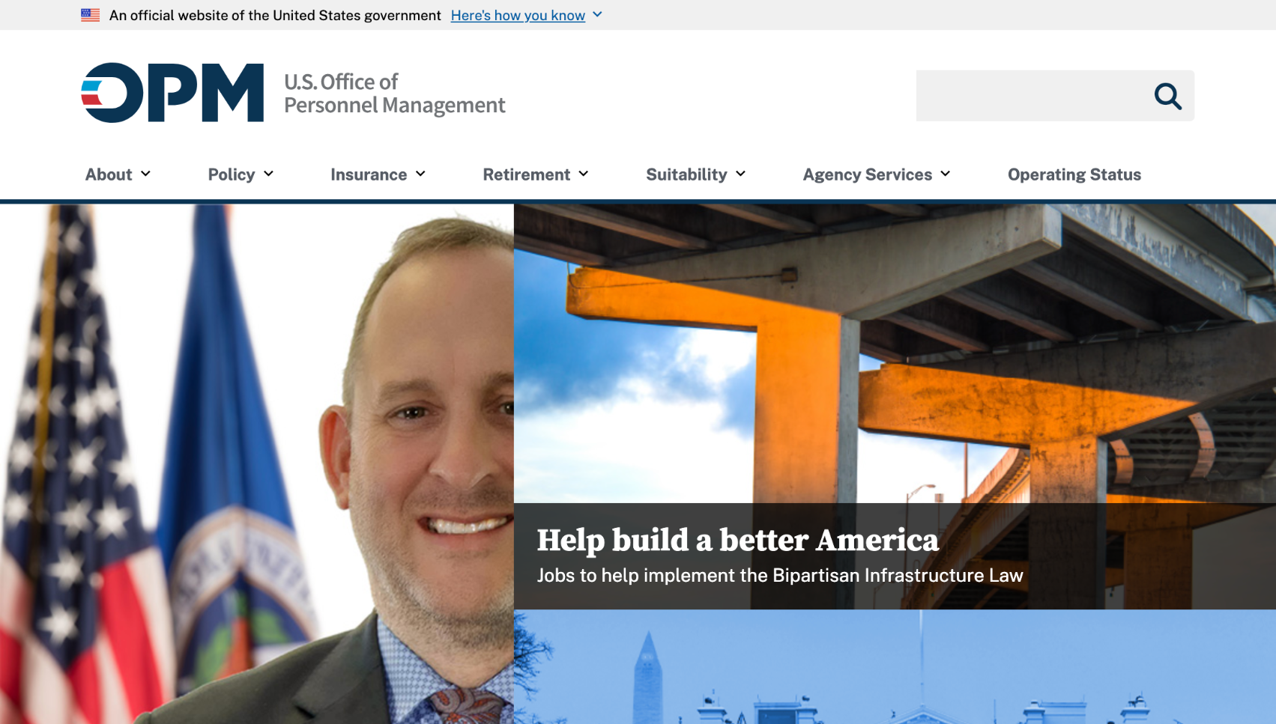
U.S. Office of Personnel Management
opm.gov

Slide 7
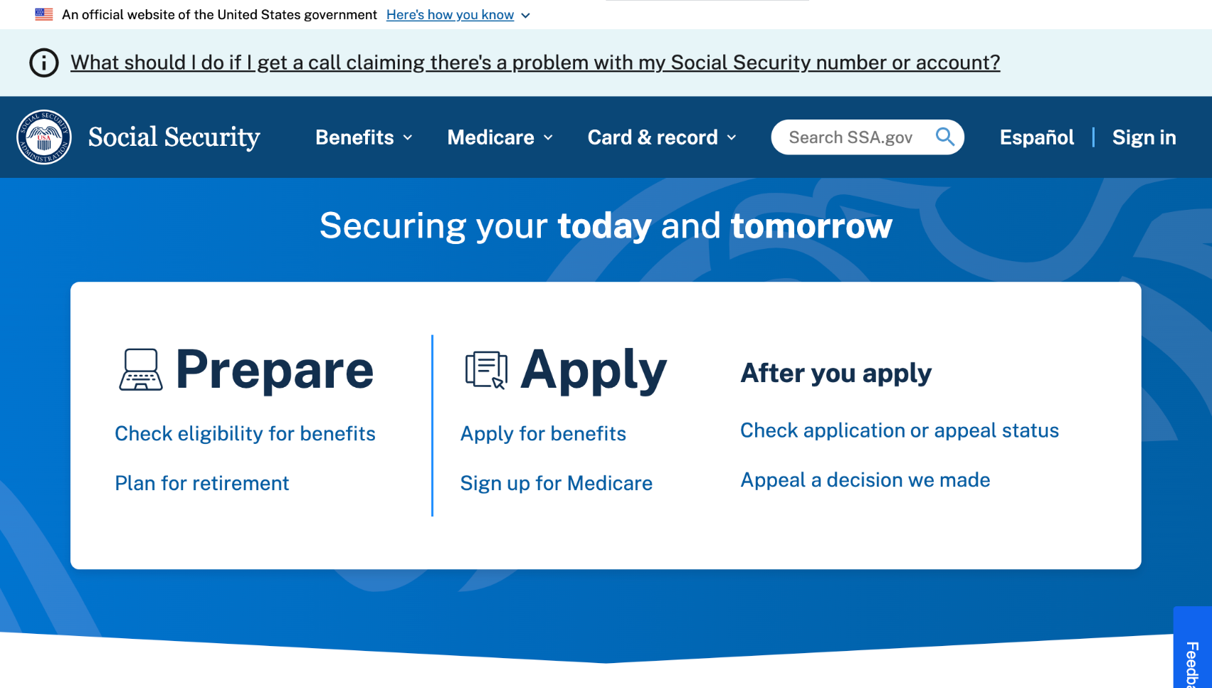
Social Security Administration
ssa.gov

Slide 8
Great work!

Slide 9
USWDS 3.4.0
Lots of small improvements

Slide 10
Key improvements in USWDS 3.4.0 (1 of 2)
Improve and normalize display of disabled inputs
Improve contrast of incomplete step indicator steps
Allow full-page width headers
Remove grid dependency from usa-banner package
Properly vocalize secondary navigation items

Slide 11
Key improvements in USWDS 3.4.0 (2 of 2)
Allow date pickers inside modals
Improve wrapping of external links and icons
Improve URL display for in-page navigation links
Allow any spacing unit in alert padding settings
Fixed broken outline-05 utility
Allow custom file formats for @font-face rules 🎉

Slide 12
USWDS 3.4.0
Out this month

Slide 13
Top Tasks Survey
Help us know what’s
important to you!

Slide 14
USWDS Design Tokens

Slide 15
Amy Leadem
she/her
Front End Developer
USWDS Core Team
Contractor

Slide 16
James Mejia
he/him
Engineer
USWDS Core Team
Contractor

Slide 17
I don’t like getting my hair cut

Slide 18
Language and choice
go together

Slide 19
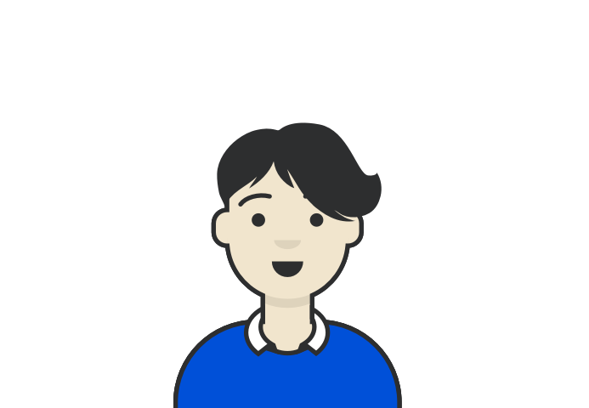
My avatar

Slide 20
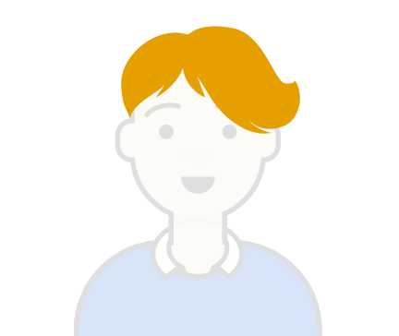
Let’s look at its haircut
Shaggy

Slide 21
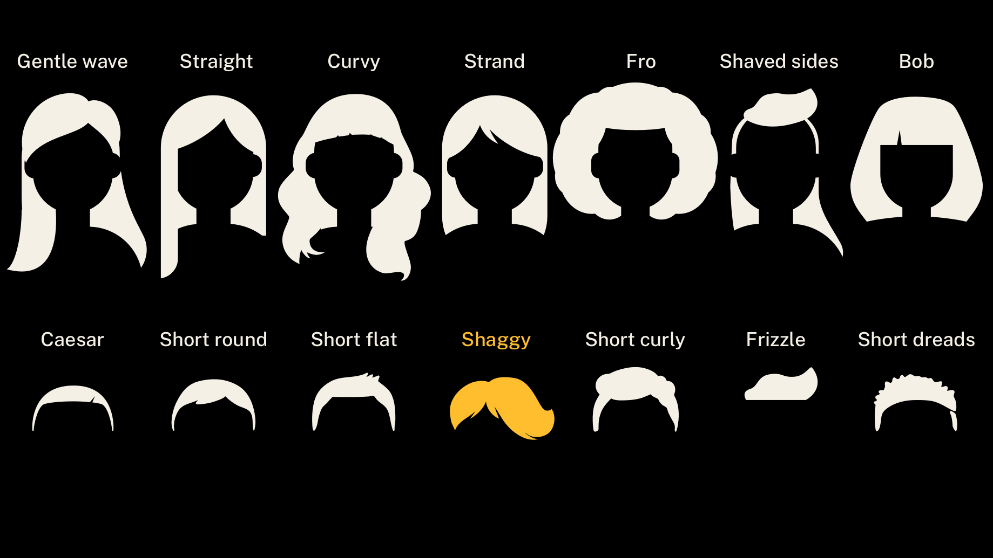
Hairstyles
Gentle Wave
Straight
Curvy
Straight Strand
Fro
Shaved Sides
Bob
Caesar
Short Round
Short Flat
Shaggy
Short Curly
Frizzle
Short Dreads

Slide 22
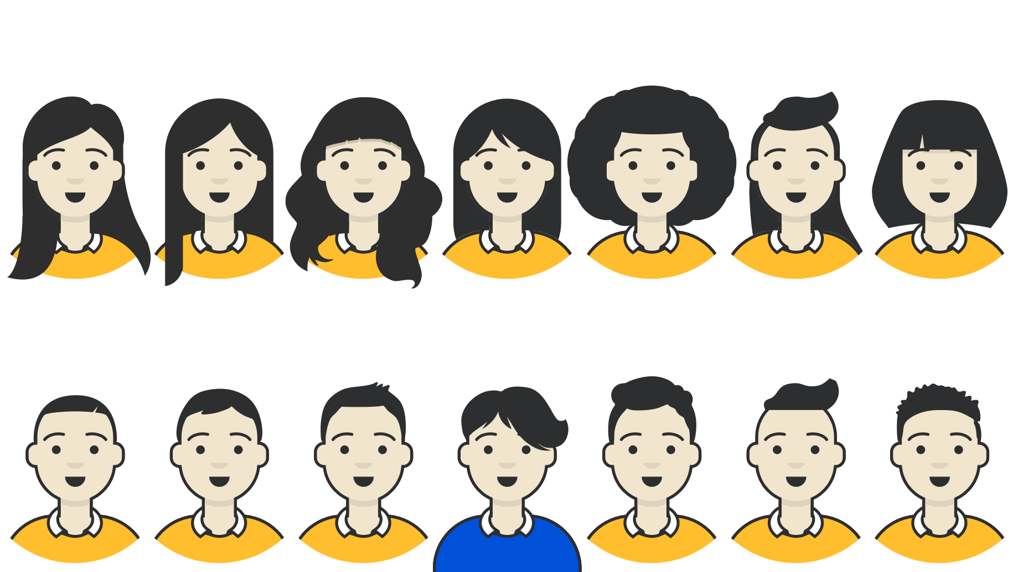
Each of these hairstyles is a choice in the avatar builder
Gentle Wave
Straight
Curvy
Straight Strand
Fro
Shaved Sides
Bob
Caesar
Short Round
Short Flat
Shaggy
Short Curly
Frizzle
Short Dreads

Slide 23
Each hairstyle choice is what we can call a hairstyle token .
Gentle Wave
Straight
Curvy
Straight Strand
Fro
Shaved Sides
Bob
Caesar
Short Round
Short Flat
Shaggy
Short Curly
Frizzle
Short Dreads

Slide 24
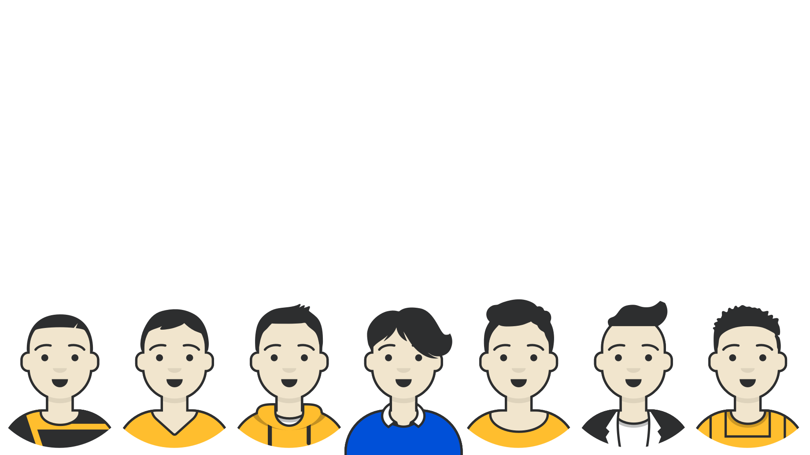
Clothing tokens
Scoop
Neck
Overalls
Collar + Sweater
Blazer + Crewneck
Graphic tee
V Neck
Hoodie

Slide 25
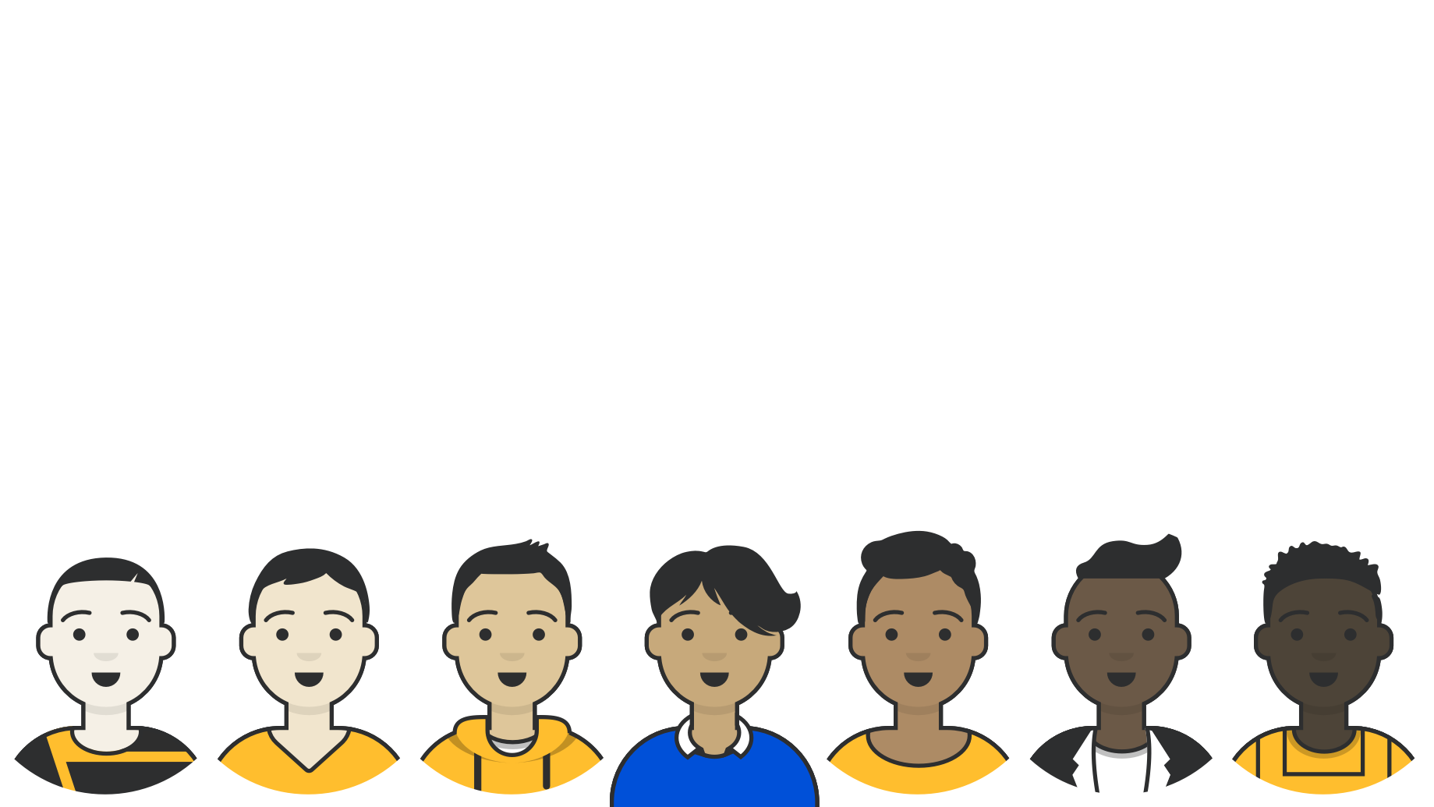
Skin Tone tokens
Tone 4
Tone 6
Tone 3
Tone 5
Tone 0
Tone 1
Tone 2

Slide 26
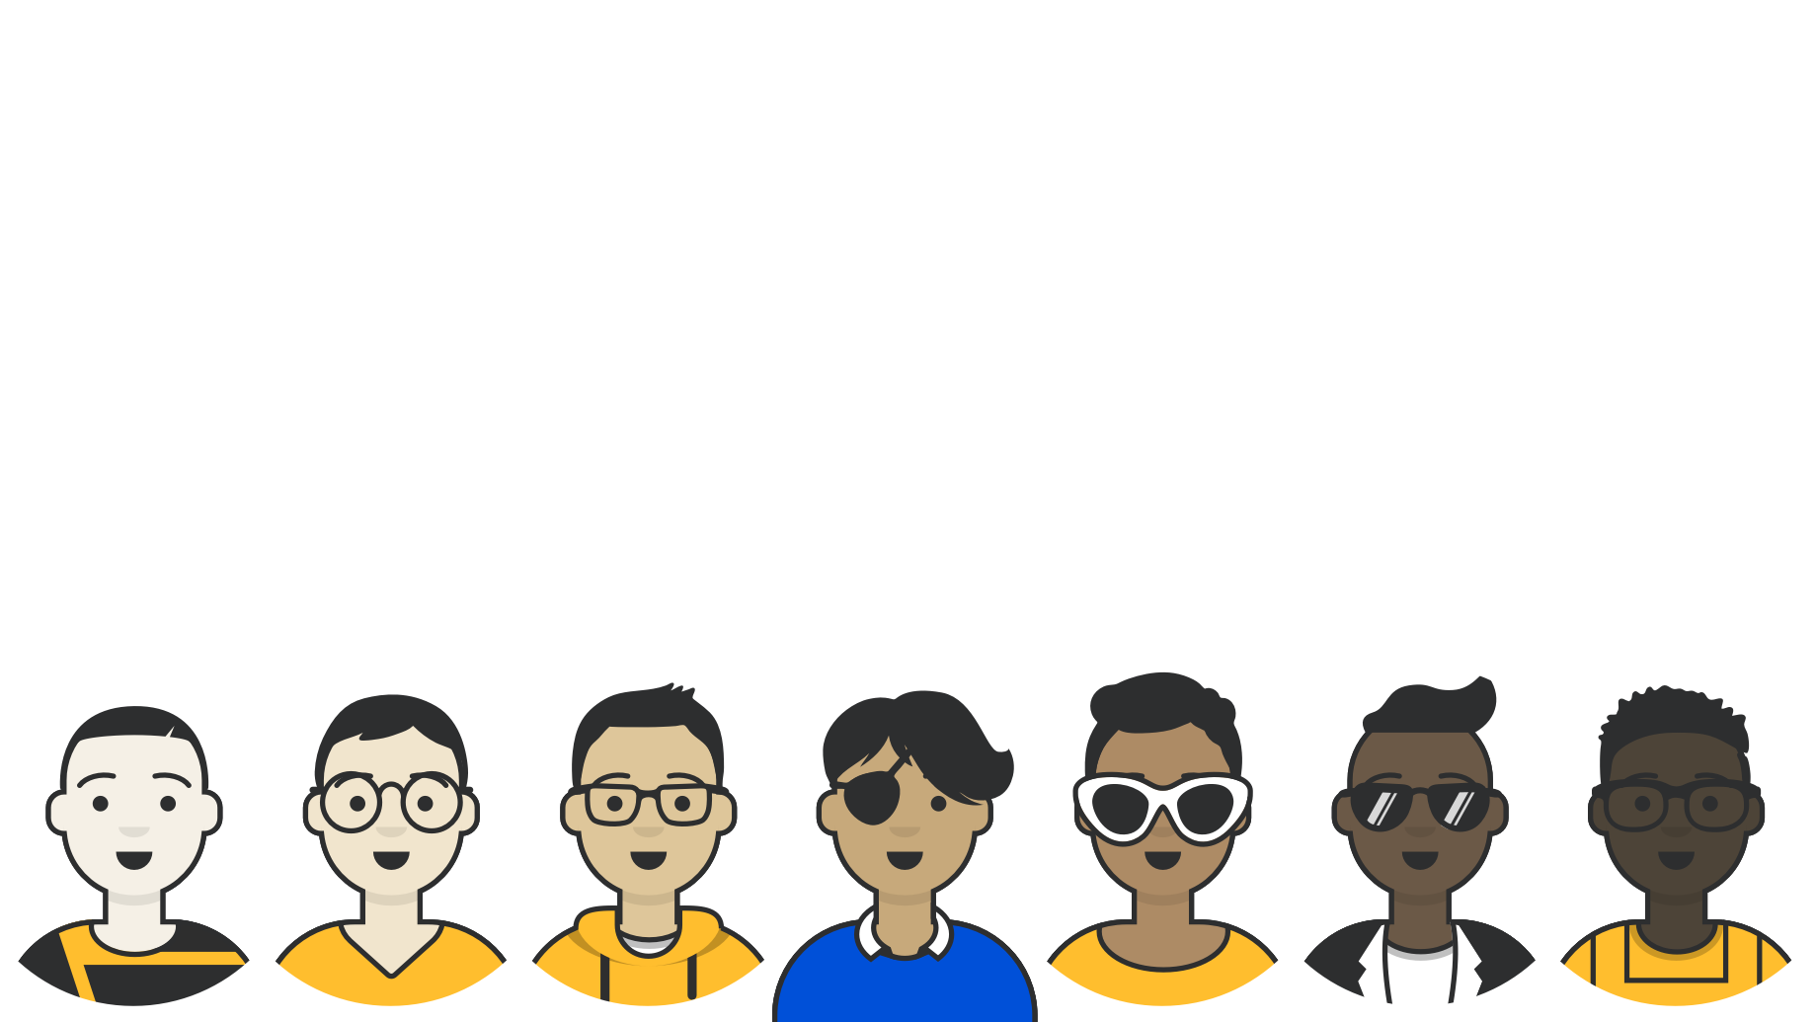
Eyewear tokens
Kurt
Prescription 2
Prescription
1
Eyepatch
Deal With It
None
Round

Slide 27
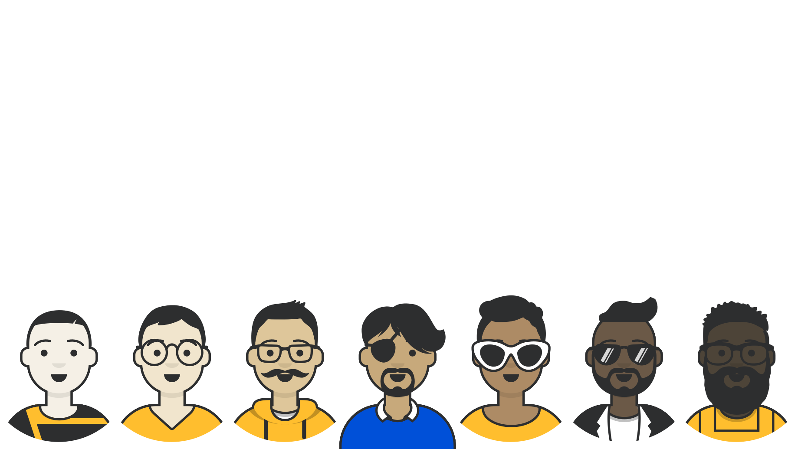
Facial Hair tokens
None
Heavy Beard
Fancy Mustache
Goatee
Light Beard
None
None

Slide 28
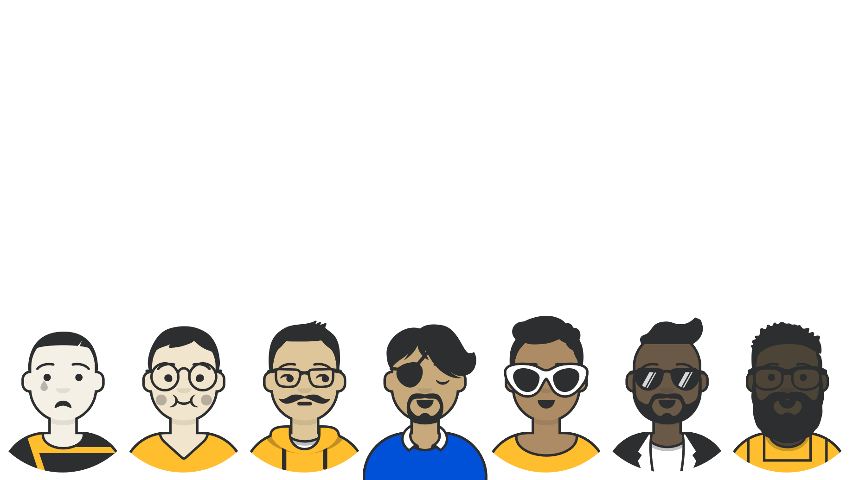
Eyes and Mouth tokens
Default
Default
Cry/ Sad
Teardrop/ Eating
Side/ Serious
Closed/ Default
Default

Slide 29
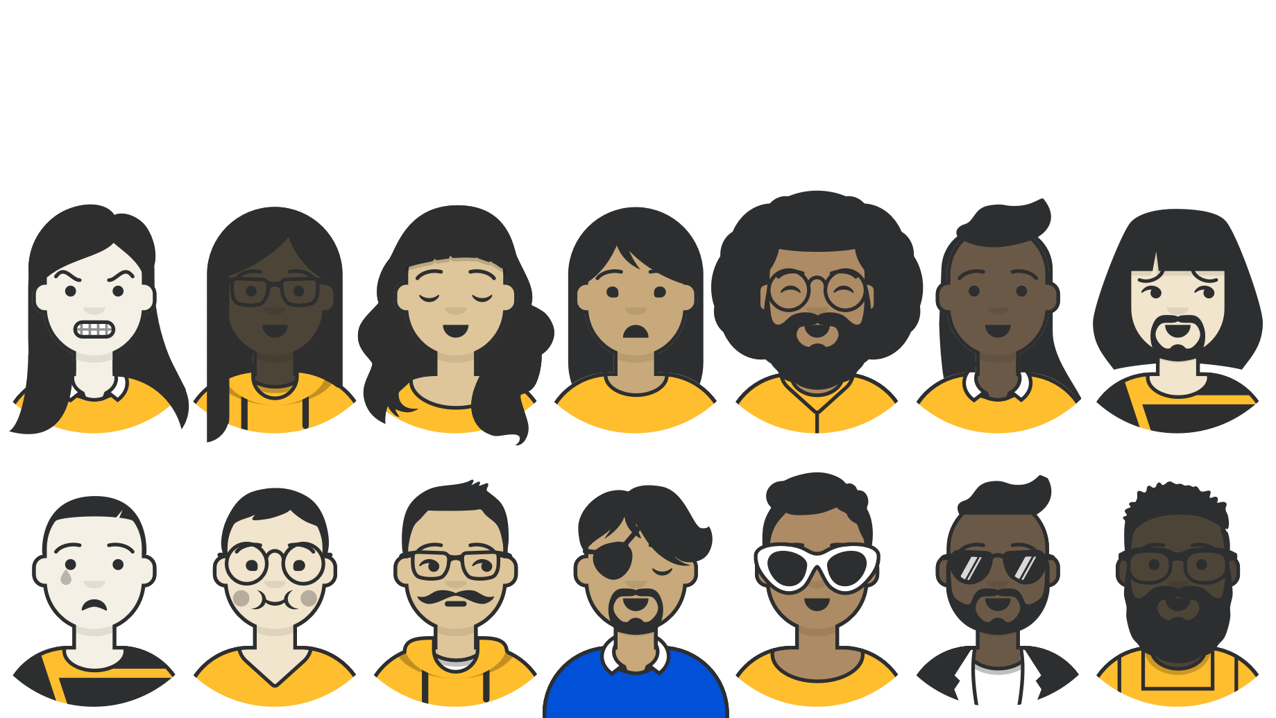
Expressive range
Even limited tokens can have a wide expressive range

Slide 30
What is “good enough”?

Slide 31
Design tokens in my avatar
The building blocks of avatar design
Eyewear
Eyes
Hairstyle
Facial Hair
Skin Color
Clothes
Mouth

Slide 32
Design tokens in USWDS
The building blocks of a button
Font size
Font weight
Font family
Border radius
Padding
Color
Save and continue
Margin
Shadow
Background color

Slide 33
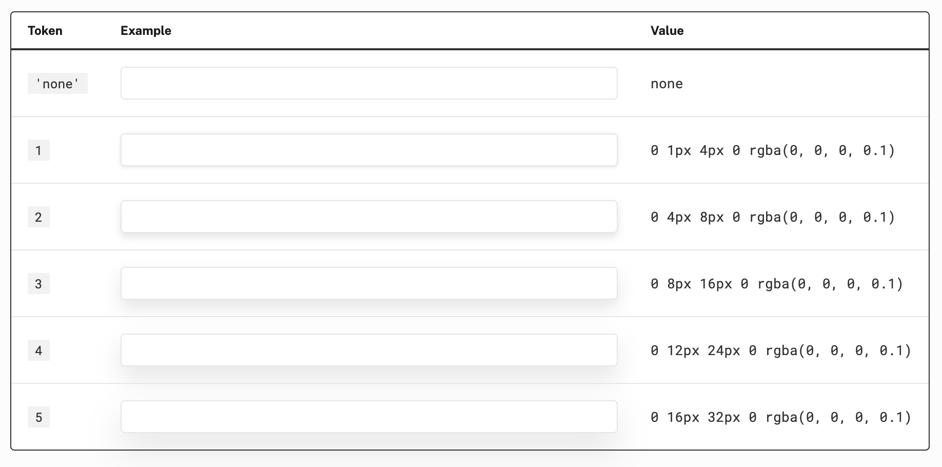
Token names instead of CSS values

Slide 34
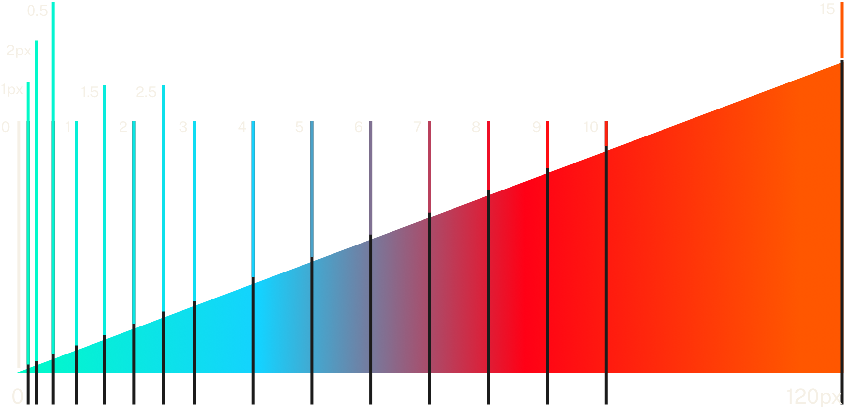
Spacing token distribution

Slide 35
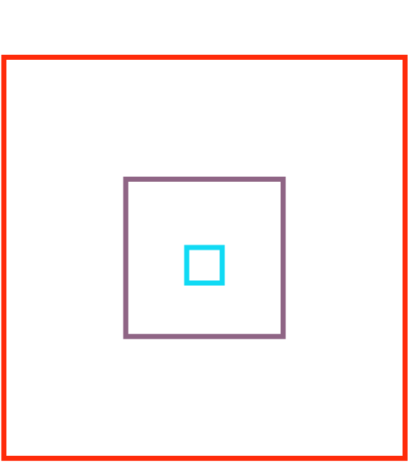
Spacing tokens always center evenly

Slide 36

The rgb color space
Over 16 million possible colors.
Where’s #73b3e7?
Here it is!

Slide 37
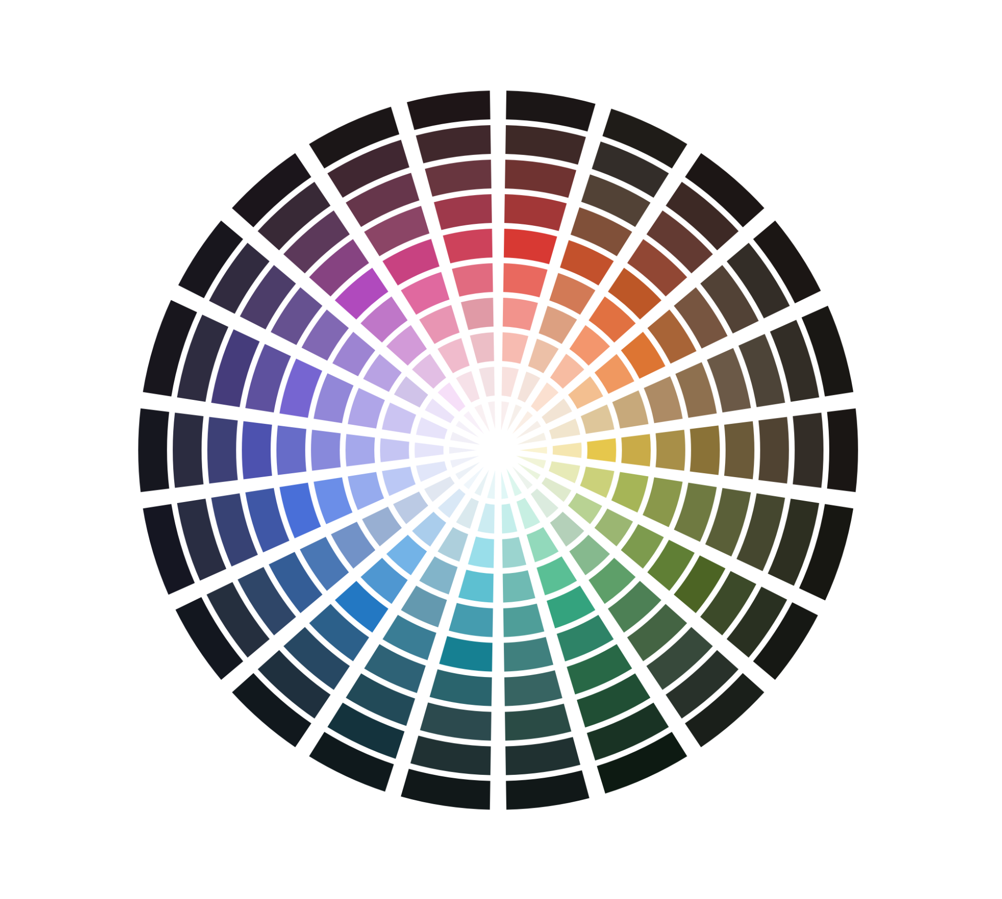
USWDS system color tokens
Over 400 colors in 25 color families, like red and blue-warm

Slide 38
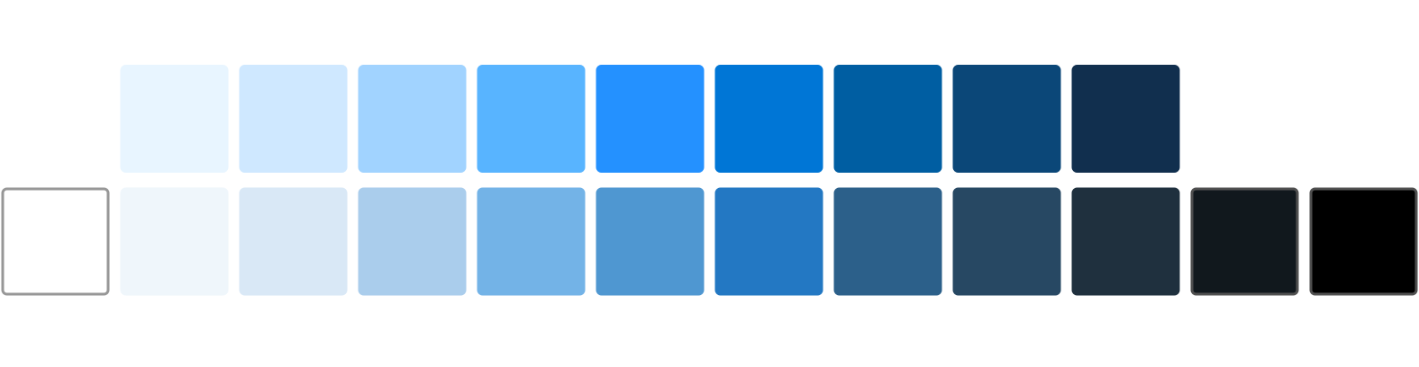
Color grades indicate brightness. Vivid variants are more intense.

Slide 39
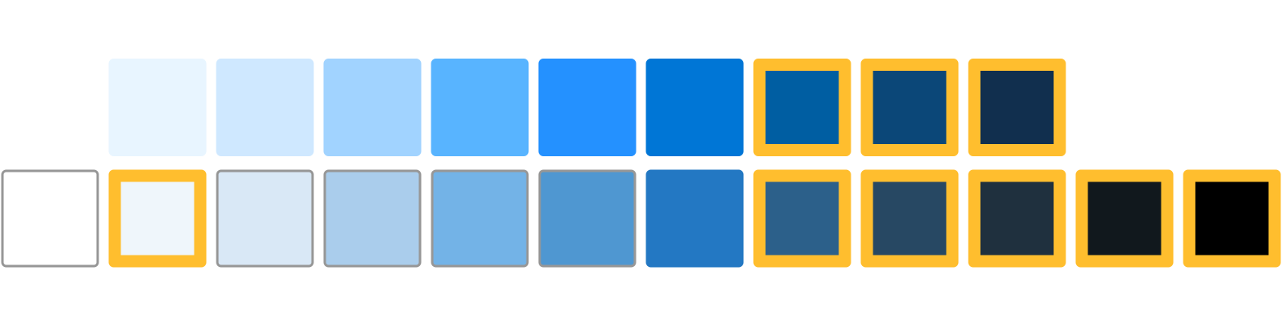
Magic number is the difference between any two color grades, in any family.
Magic numbers of 50+
achieve WCAG AA contrast.

Slide 40
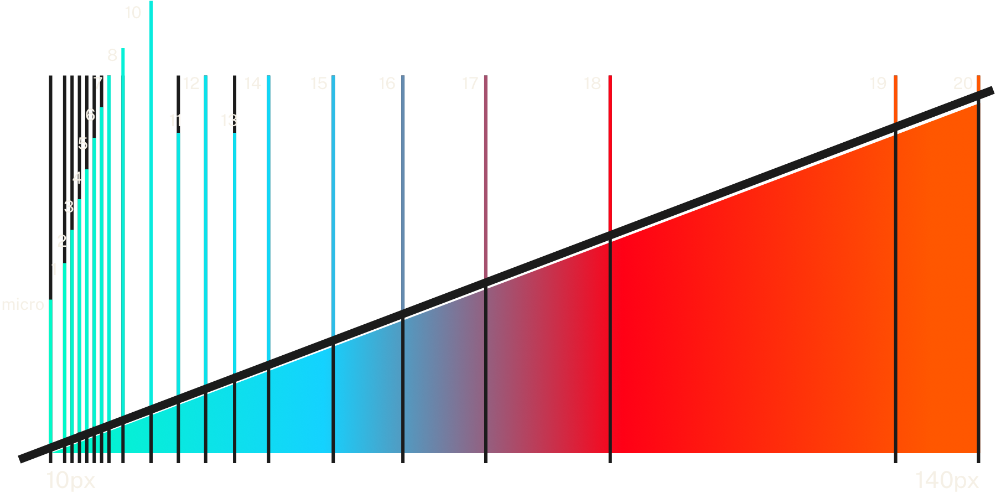
Font size token distribution

Slide 41
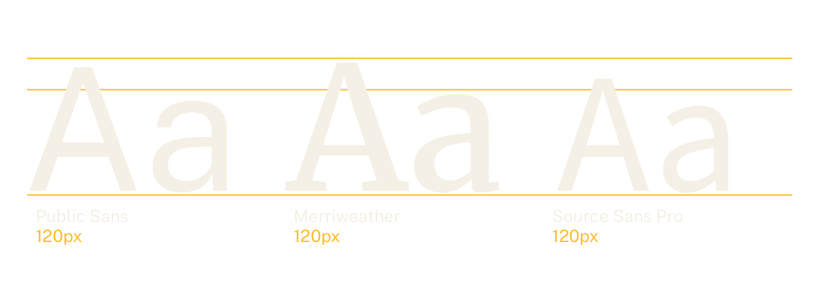
Font size without normalization

Slide 42
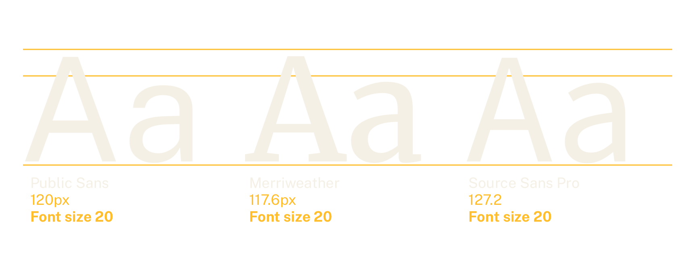
Font size with token normalization

Slide 43
System tokens and theme tokens

Slide 44
Theme tokens allows teams to create project-specific subsets of design tokens

Slide 45
Theme spacing tokens
Theme token . . System token
3xs . . . . . . 2
2xs . . . . . . 3
xs . . . . . . 4
sm . . . . . . 5
md . . . . . . 6
lg . . . . . . 9
xl . . . . . . 12
2xl . . . . . . 14
3xl . . . . . . 15
T-shirt sizing

Slide 46
Theme color tokens
Theme token . . System token
primary . . . . green-cool-50
primary-dark. . green-cool-60
primary-darker. green-cool-70
primary-light . green-cool-40
primary-lighter green-cool-30
primary-vivid . green-cool-40v
secondary . . . orange-warm-50
accent-cool . . mint-cool-50
accent-warm . . gold-50
base . . . . . gray-warm-50
...
Role and lightness

Slide 47
State color tokens
Theme token . . System token
error . . . . . red-50v
error-dark . . red-60v
error-darker . red-70v
error-light . . red-40
error-lighter . red-30
warning . . . . gold-40
success . . . . mint-cool-40v
info . . . . . blue-cool-30
emergency . . . red-warm-50v
disabled . . . gray-60
...
Role and lightness

Slide 48
Font type tokens
Theme token . . System token
sans . . . . . public-sans
serif . . . . . merriweather
mono . . . . . roboto-mono
lang . . . . . public-sans
icon . . . . . false
What type of font is it?

Slide 49
Font role tokens
Theme token . . Font token
ui . . . . . . sans
heading . . . . serif
body . . . . . sans
code . . . . . mono
alt . . . . . . serif
How are you using this font?

Slide 50
Check for tokens when making design decisions. It might just make your life easier!

Slide 51
Using tokens in code

Slide 52
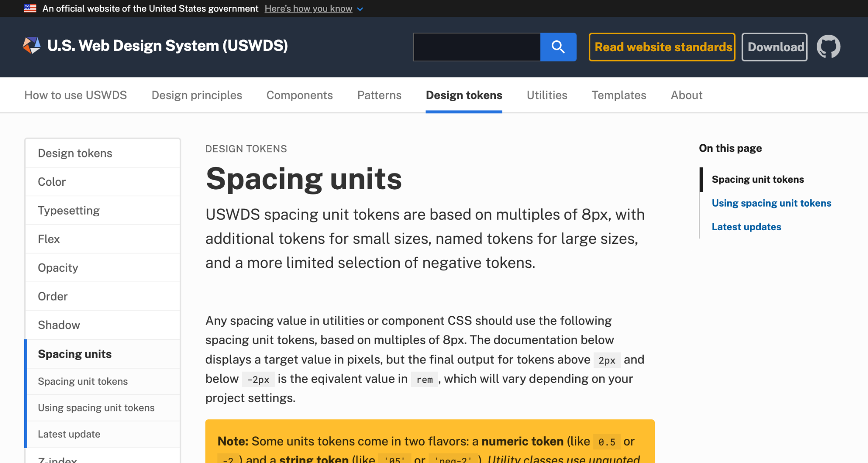
Example: Spacing Units

Slide 53
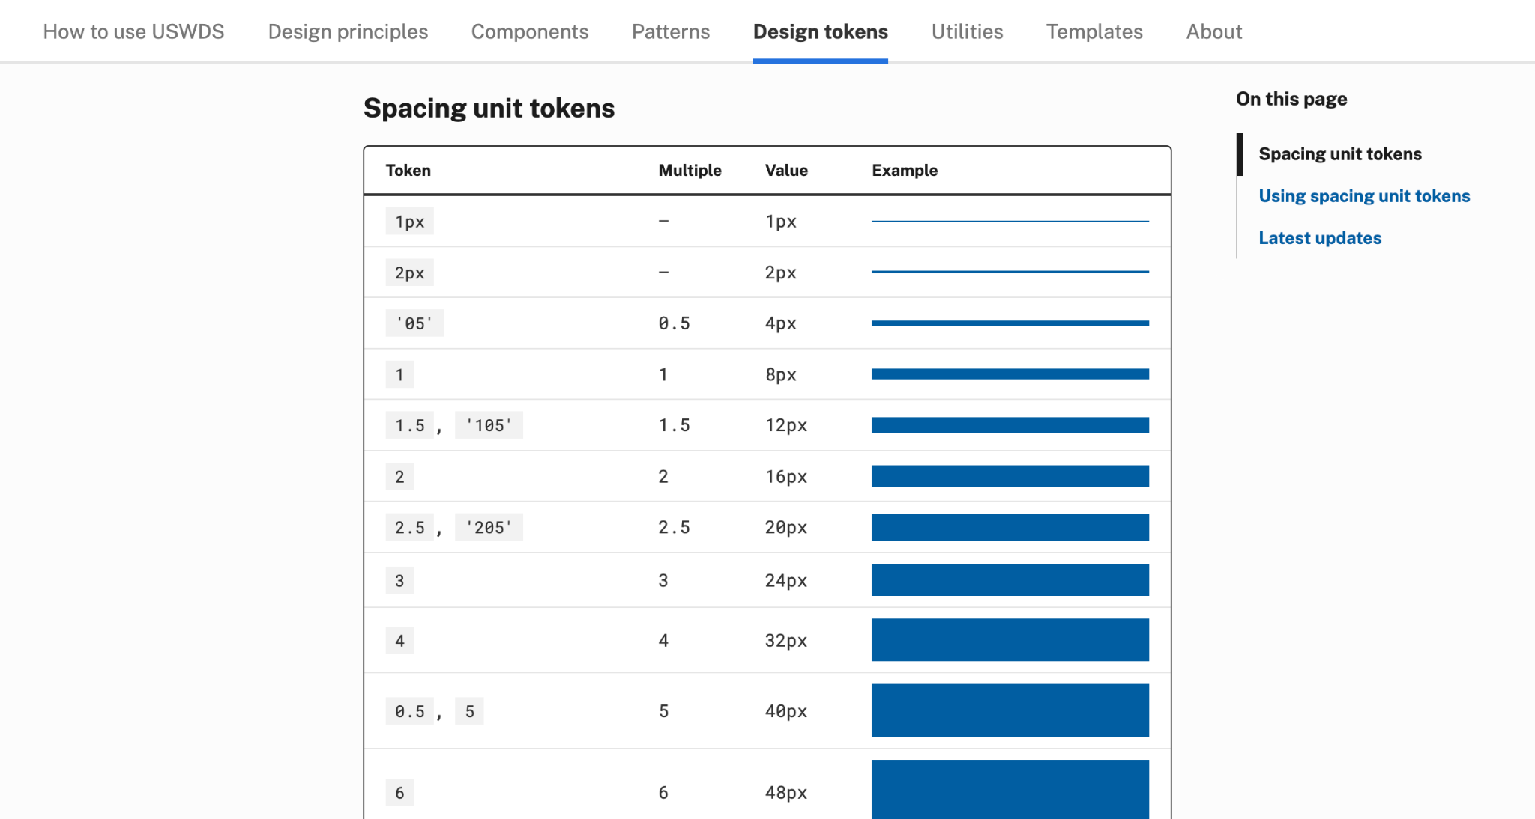
Spacing unit tokens

Slide 54
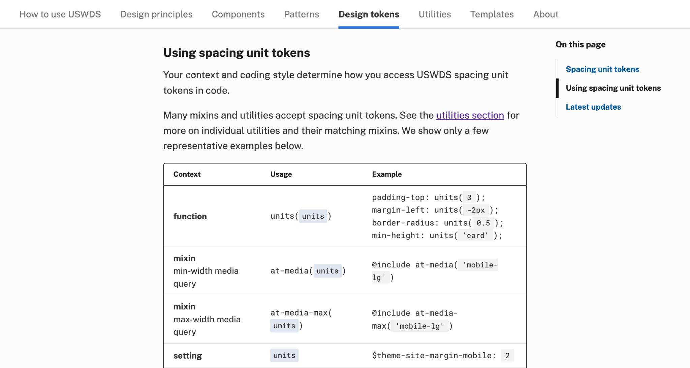
Using spacing unit tokens

Slide 55
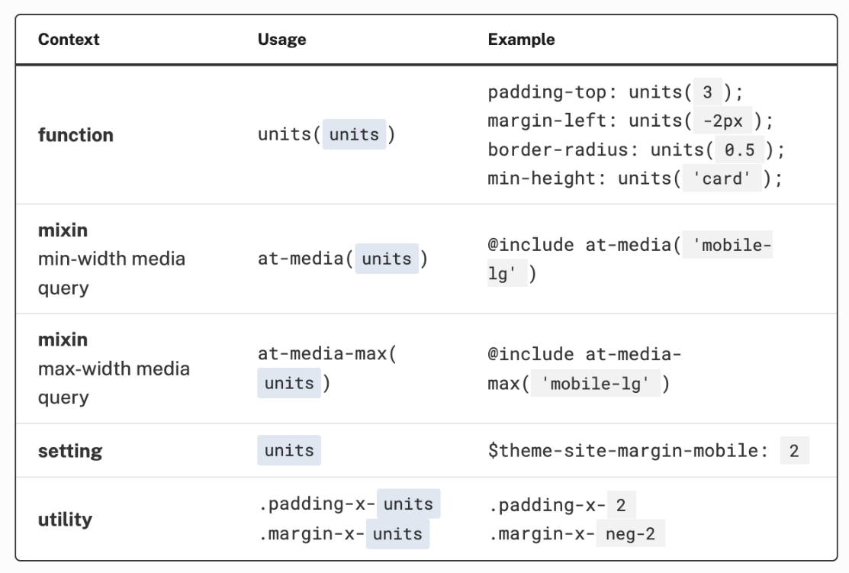
Accessing tokens
Functions,
mixins,
utilities,
settings

Slide 56
Using tokens with functions
property: function("token");

Slide 57
Using tokens with mixins
@include u-mixin("token");

Slide 58
Using tokens in markup with utilities
class="utility-token"

Slide 59
Using tokens in settings
$theme-setting-name: "token";

Slide 60


Example with functions
.example {
background-color: color("primary");
color: color("white");
font-family: family("sans");
font-size: size("sans", "xl");
padding: units(1);
}
.example-two {
background-color: color("transparent");
color: color("gold-20v");
font-family: family("serif");
font-size: size("serif", "xl");
padding: units(2.5);
}

Slide 61
Example with mixins
.example {
@include u-bg("primary");
@include u-color("white");
@include u-font("sans", "xl");
@include u-padding(1);
}
.example-two {
@include u-bg("transparent");
@include u-color("gold-20v");
@include u-font("serif", "xl");
@include u-padding(2.5);
}

Slide 62
Example with utilities in markup
<div
class="example bg-primary
color-white font-sans-xl padding-1">
Hello.
</div>
<div
class="example-two bg-none
color-gold-20v font-serif-xl
padding-205">
Hello.
</div>

Slide 63
Use tokens any way you like.
Just try and use them!

Slide 64
A common language

Slide 65
Maybe this will be me next time

Slide 66
Q&A

Slide 67
Next month
March: Design and the brain
#uswds-public
github.com/uswds
designsystem.digital.gov

